Slide 1
Types of Attacks
Active Attacks
Passive Attacks

Slide 2
Active Attacks
Flooding
Spoofing
Padding
DoS & DDoS
Replay
Masquerade
Modification
Passive Attacks
Footprinting
Monitoring
Eavesdropping
Traffic Analysis

Slide 3
Types of Attacks
Malware Attacks
Password Attacks
Denial of Service Attack
Social Engineering Attack
SQL Injection Attacks
Man in the Middle Attack

Slide 4
Types of Attacks
Malware Attacks
Password Attacks
Denial of Service Attack
Social Engineering Attack
SQL Injection Attacks
Man in the Middle Attack

Slide 5
Phishing Attack
Social Engineering Attacks

Slide 6
Dictotionary Attacks
Brute Force
Password Attacks
Keylogger
Rainbow Table Attack
Shoulder surfing

Slide 7
Pre Connection Attacks
Post Connection Attacks
Man in the Middle Attack (MIMT)

Slide 8
Important
Trozan hourse is also called trapdoor.

Slide 9
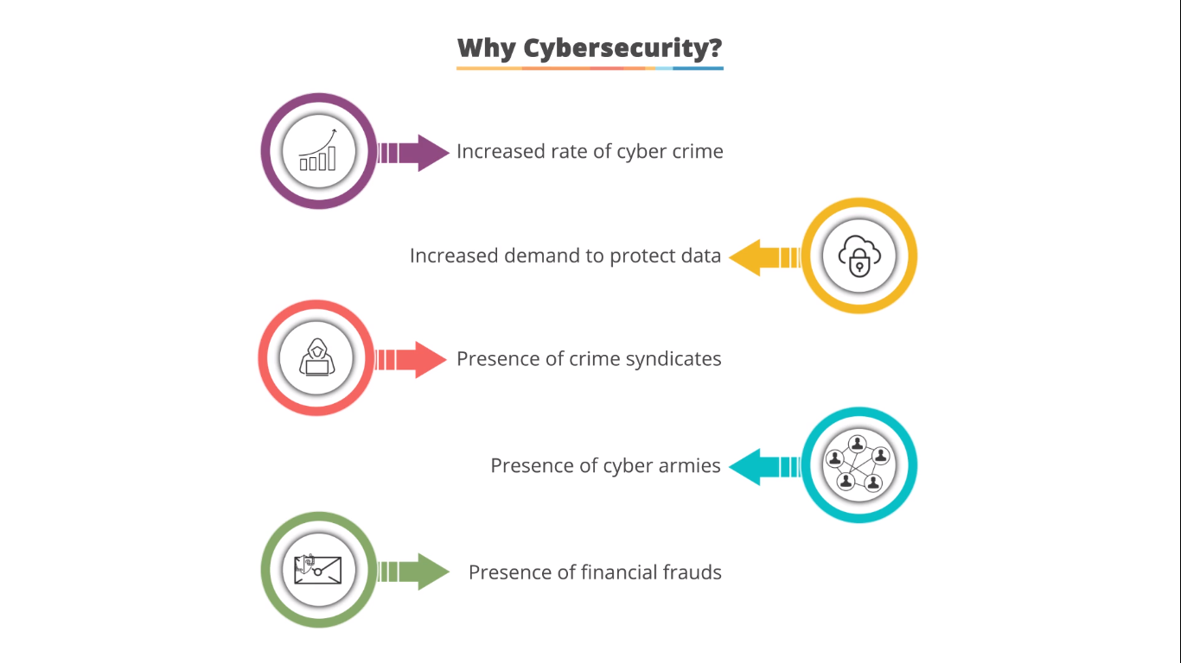
Why cybersecurity
Increase rate of cyber crime
Increased demand to protect data
Presence of crime syndicates
Presence of Cyber Armies
Presence of financial frauds

Slide 10
Information vs Cyber Security
Information Security is the processes and tools designed to protect sensitive information (modification, disruption, and inspection)
Cyber Security is a set of techniques used to protect the integrity of networks, programs, and data (attack, damage and unautherised access).

Slide 11
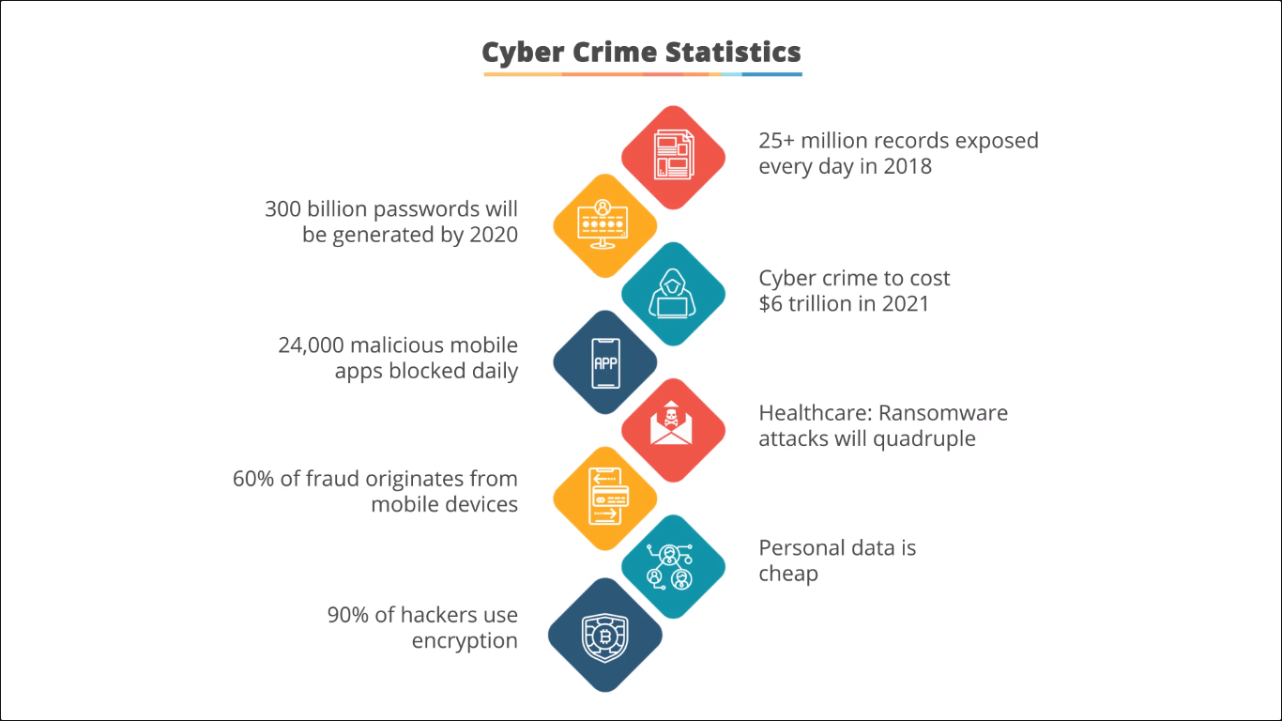

Slide 12
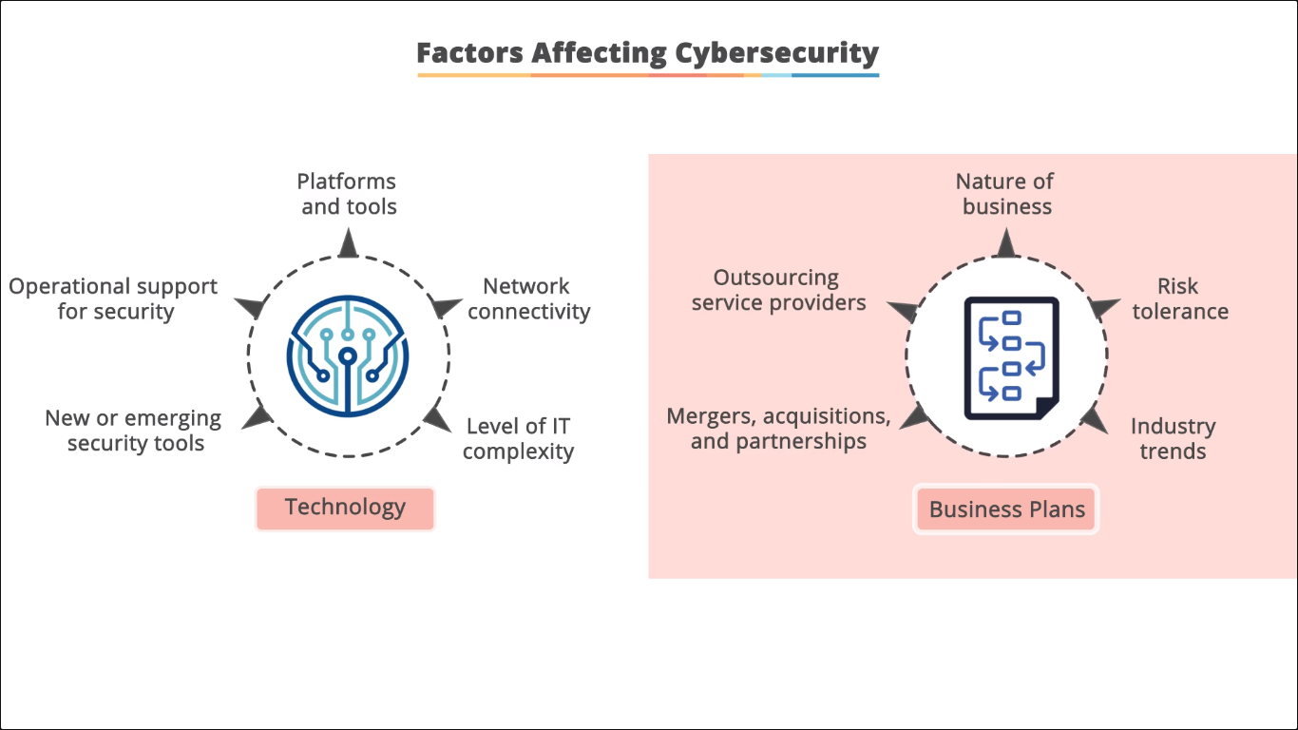

Slide 13
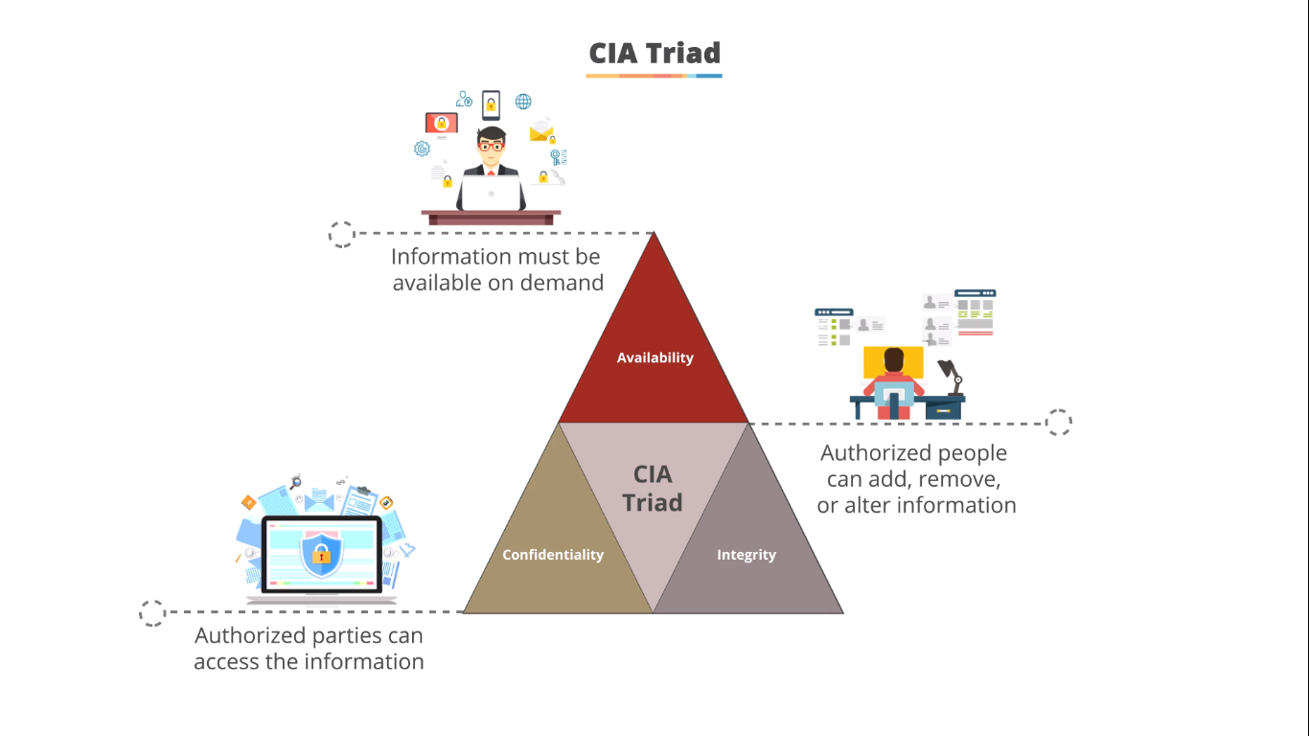

Slide 14
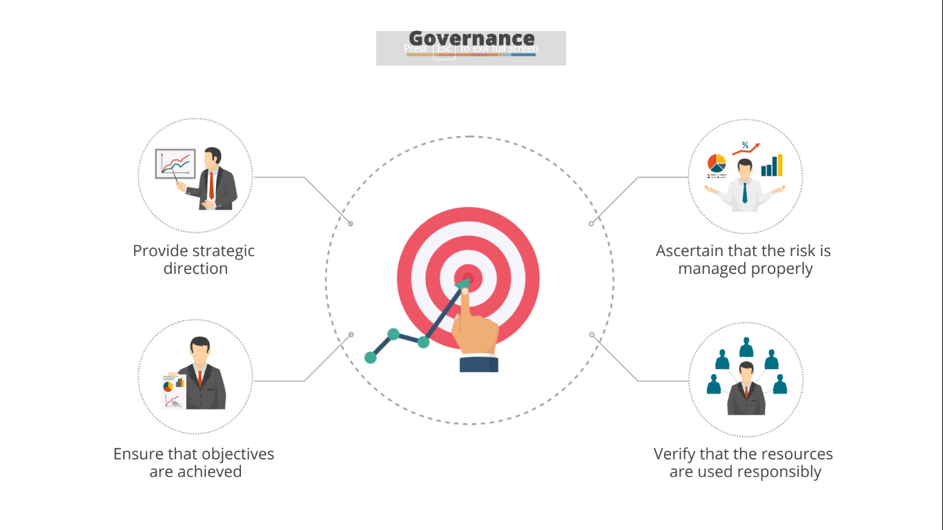

Slide 15
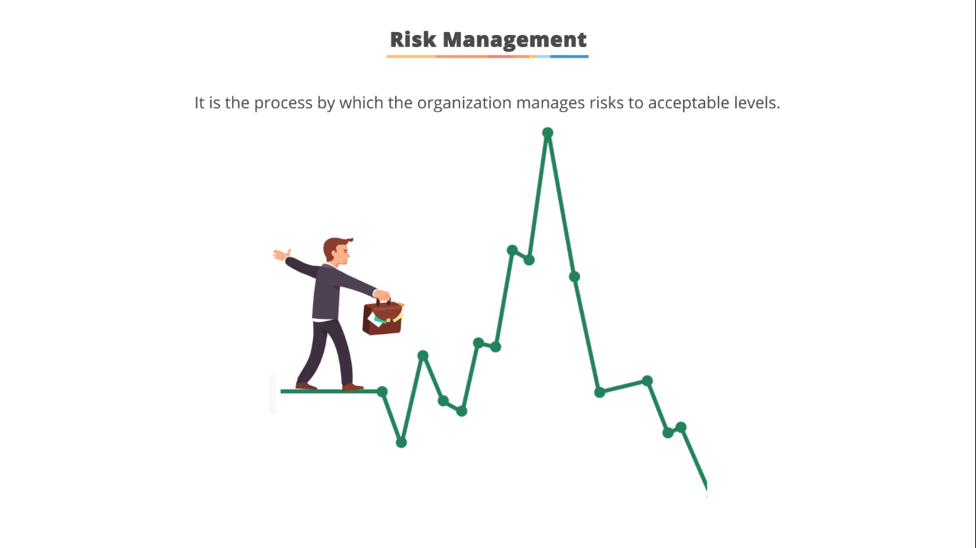

Slide 16
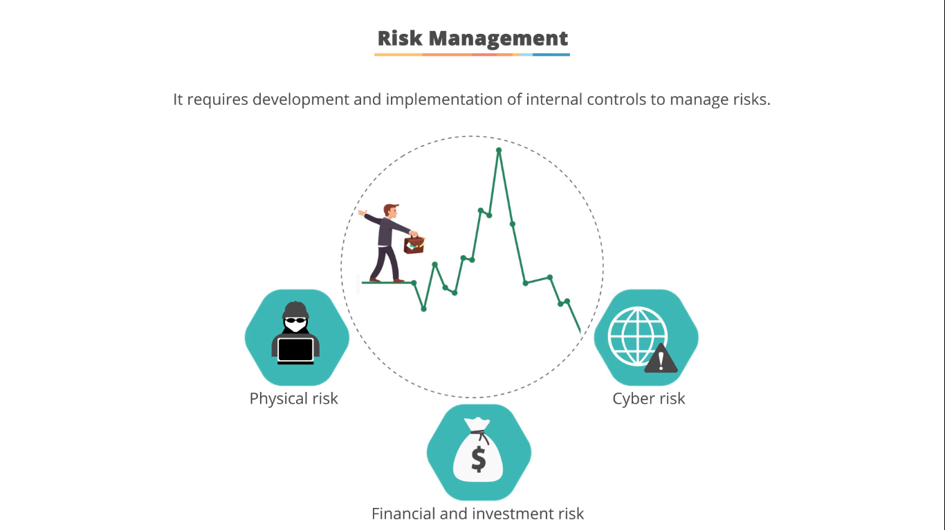

Slide 17


Slide 18
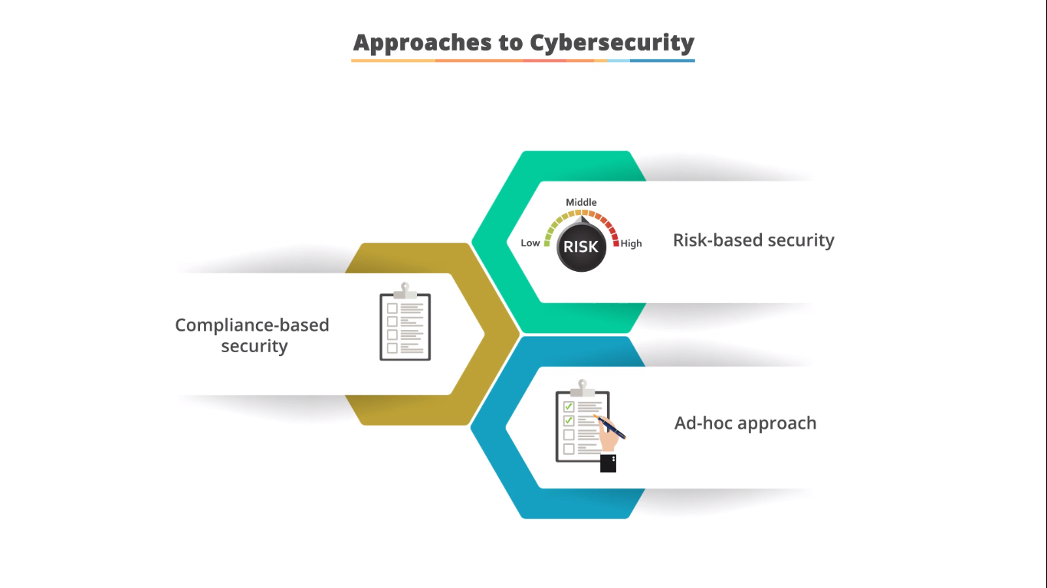

Slide 19
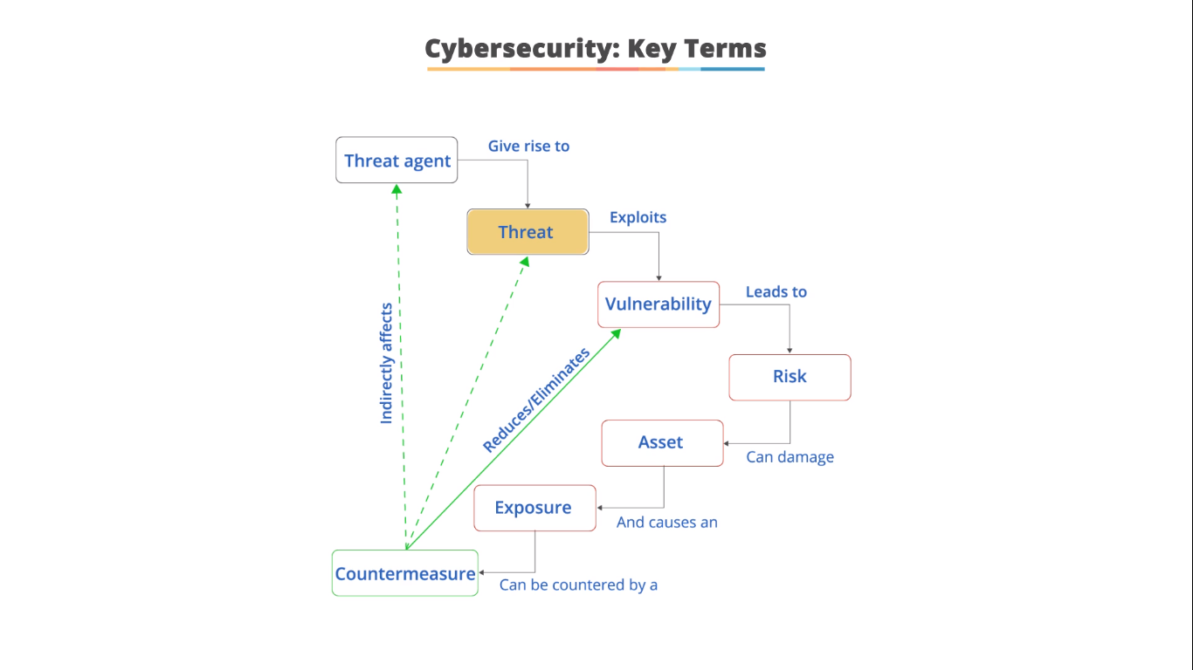

Slide 20
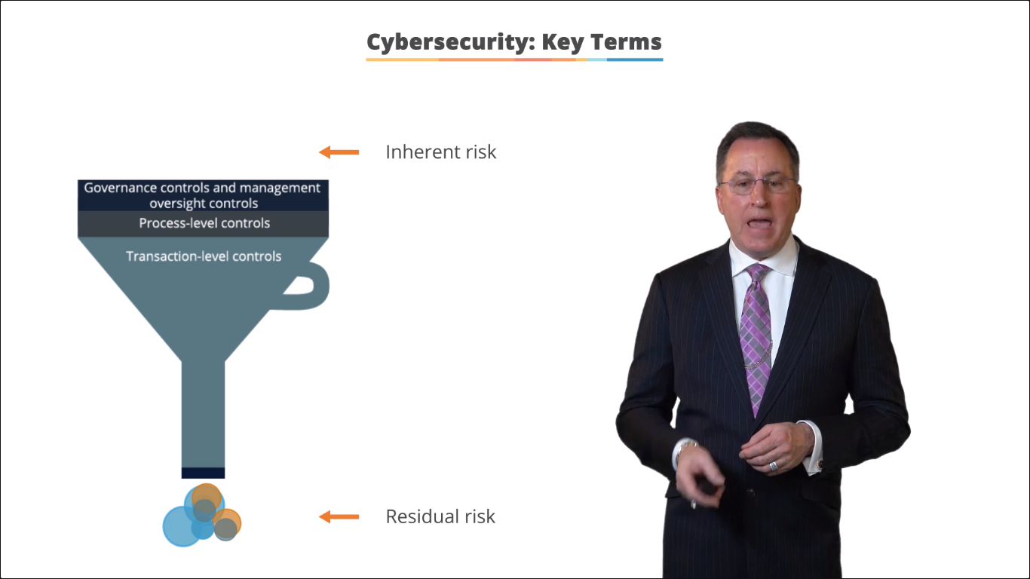

Slide 21
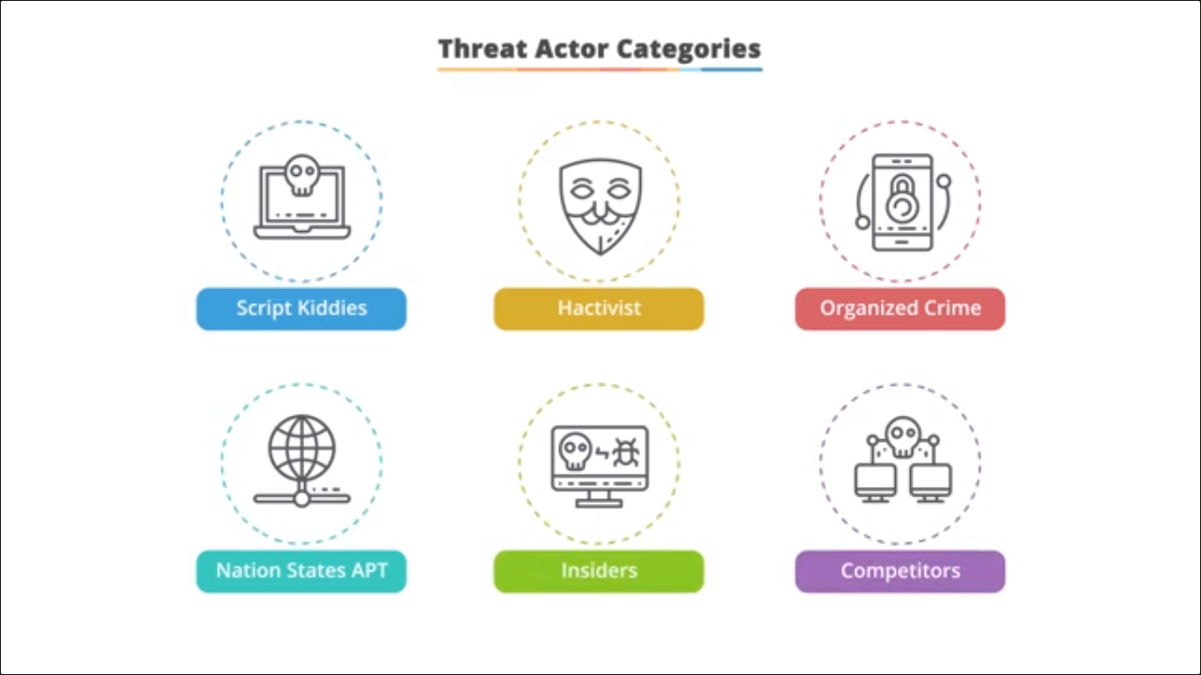

Slide 27
10. April 27 2007 Astonia
9. December 23 2015 Ukraine Power Outage
Top 10 Cyber Attacks
8. 1999 21 Shutdown NASA Computers
7. November 2014 Sony Confidential data leak
6. Dec 2006 TDX US 45 million Debit & Credit Card Info Stolen
5. 2010 Stuxnet Malware, infected more than 2 lac computers in IRAN, spread via windows
4. April to September 2014 56 million payment cards and 53 million email addresses were compromised
April 2011 Sony 77 million users from playstation network.
2. May 2017 Wannacry Ransomeware Attack. 2 million computer across 150 country were the victim. 300 to 600 bitcoins ransome.
1. March 1999 Milisa Virus, network traffic via emails,

Slide 28
Robert T Morris (1988)
Kevin Lee (1990)
Famous Hackers
Devid L Smith (1999)
Adom Botby (2004)
Shoulder surfing

Slide 30
Additional Skills
Risk Analysis
Incident Response
Lows and Regulations
Information Security
Security Audit

Slide 31
Phases of Hacking
Scanning
Gaining Access
Maintaining Acces
Clearing Logs
Footprinting

Slide 32
Footprinting
Website Footprinting
Footprinting through Search Engine
OSINT
Email Footprinting
Footprinting using Google
DNS Footprinting
Network Footprinting

Slide 33
Footprinting Tools
Harvestor
Shodan
Wappalyzer
Traceroute
WhatWeb
Maltego
OSINT Framework
Subdomain Finder
Netdiscover
CLI Tools Tracert, Dig, Traceroute, ping, etc

Slide 34
Scanning
WP Scan
Network Mapping
NMAP Scanning
Port Scannning TCP/UDP
ICMP SCAN
IP & Ping Scan
Bypass Firewall, IDS and IPS
Scanning means Checks for Open Ports and most vulnerabilities areas in the network

Slide 35
Scanning Tools
NMAP Scan
WP Scan
Nessus Tool
Network Topology Mapper
Nicto Scan
Open VAS
Scanning means Checks for Open Ports and most vulnerabilities areas in the network

Slide 36
Phases of Penetration Testing
Reconnaissance
Threat Modelling & Vulnerability Identification
Exploitation
Post-Exploitation
Pre-Engagement Action
Reporting
Resolution and Re-Testing

Slide 38
Ways to be Secure on Intenet or any network
VPN, TOR
Firewalls, IDS and IPS
Antivirus
Regular Updates and Security Patches
Port Blocking
No Pirated / Crack Software
Not necessary cookies
Adblocker
No attachments from untrusted sources

